Slide 1
What is Literature?
Introduction to English Literature(04)
March 17, 2020
Chankil Park

Slide 2
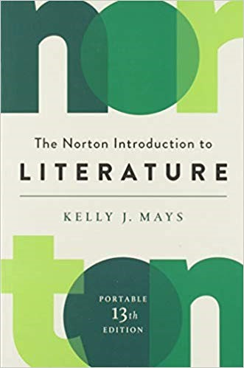
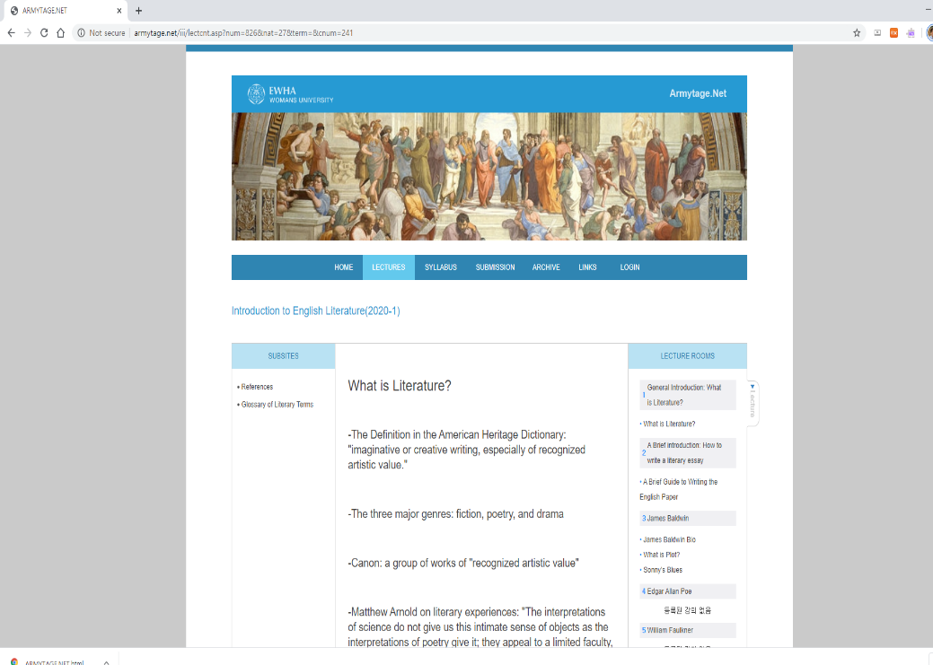
Text & Website
Text
Website: armytage.net

Slide 3
Definition
Imaginative or creative writing,
especially of recognized artistic value
From American Heritage Dictionary

Slide 4
Three Major Genres
Fiction
Poetry
Drama

Slide 5
Canon
A group of works of “recognized artistic value”

Slide 6
The Value of Literature
Matthew Arnold
"The interpretations of science do not give us this intimate sense of objects as the interpretations of poetry give it; they appeal to a limited faculty, and not to the whole man. It is not Linnaeus...who gives us the true sense of animals, or water, or plants, who seizes their secret for us, who makes us participate in their life; it is Shakespeare ...Wordsworth... Keats(4)."

